Slide 1
Analyzing the Association Between Social Media and TV Viewership for Sporting Events
Text Analytics - Final Project
Konstantin Weis
Ryan Waffle
Nicholas Mercogliano
Ramiro Baldeon

Slide 2
Problem Statement
Companies are looking to better understand how social media engagement affects their business
Which topics and terms are most discussed on social media prior to a sporting event (Super Bowl)?
Is there a correlation between social media engagement prior to a sporting event and actual television viewership numbers?
Can social media sentiment be an additional prediction variable?
Can social media be used to help predict TV viewership?

Slide 3
Data Description
Data Source - Television Viewership
Sources included: Statista, Nielsen and Sports Media Watch
https://www.sportsmediawatch.com/2019/01/top-sports-audiences-2018-list/ (Top 50 in 2018) https://www.statista.com/statistics/619023/number-tv-viewers-sporting-events-usa/ (Top 25 in 2018)
https://www.nielsen.com/us/en/insights/article/2018/tops-of-2018-television/ (Top TV Programs of 2018 - Single Telecast)

Slide 4
Data Description
# | GAME | RTG | Total Viewers - TV (TV + Other) | NET
1 | Chiefs-49ers SuperBowl LIV | 41.6 | 100.45M (117.607M) | FOX
2 | Patriots-Rams SuperBowl LIII | 41.1 | 98.19M (113.263M) | CBS
3 | Eagles-Patriots SuperBowl LII | 43.1 | 103.39M (117.953M) | NBC
4 | Patriots-Falcons SuperBowl LI | 45.3 | 111.32M (113.69M) | FOX
5 | Broncos-Panthers SuperBowl 50 | 46.6 | 111.86M (113.732M) | CBS
6 | Patriots-Seahawks SuperBowl XLIX | 47.5 | 114.44M (115.781M) | NBC
7 | Seahawks-Broncos SuperBowl XLVIII | 46.7 | 112.19M (113.282M) | FOX
8 | Ravens-49ers SuperBowl XLVII | 46.4 | 108.69M (109.198M) | CBS
9 | Giants-Patriots SuperBowl XLVI | 47 | 111.35M (111.696M) | NBC
10 | Packers-Steelers SuperBowl XLV | 46 | 111.01M (111.01M) | FOX

Slide 5
Data Description
Data Source & Data Collection - Tweets
With Twitter’s strong social media presence, it's an ideal candidate for our audience engagement
Crawl tweets using #SuperBowl hashtag
Data range: Two weeks prior to each Super Bowl from Super Bowl 2011 to Super Bowl 2020
75,000 - 200,000 tweets collected per Super Bowl

Slide 6
Methodology
1
2
3
4
5
Data collection
Text Representation
Evaluation
Data pre-processing and Representation
Analysis and Modeling
Crawl Tweets with Twint using #SuperBowl Hashtag
Tweet cleaning
Tokenization
Stop Word Removal
Term Frequency
Common n-grams
Topic Modeling
Performance
Comparison
Conclusions

Slide 7
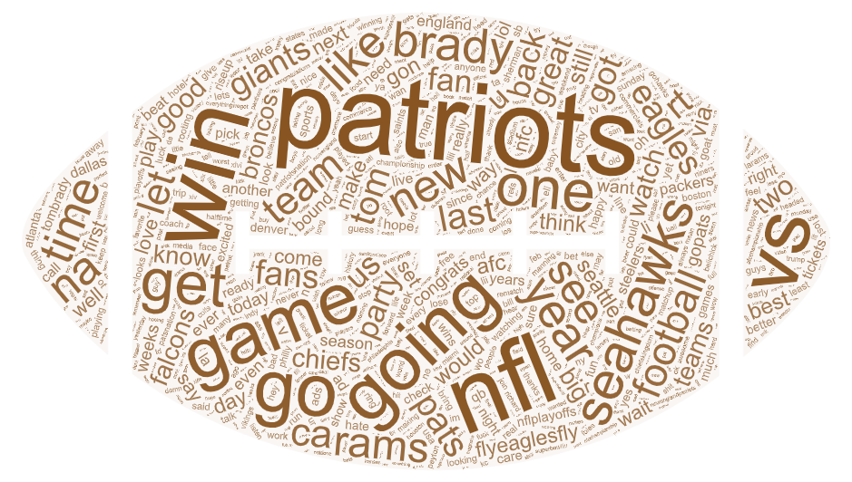
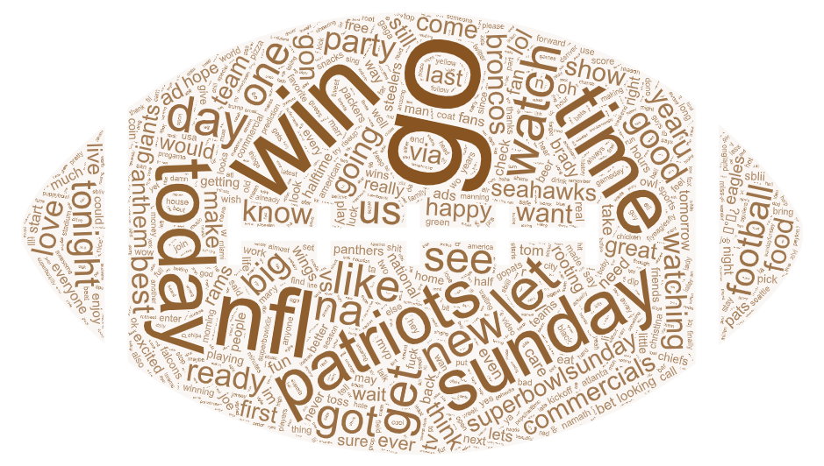
Text Representation - Term Frequency
Two Weeks Out
Game Day
Team names feature prominently two weeks out from game day
Game day tweets feature positive messages and encouragement for the teams: go, win, ready

Slide 8
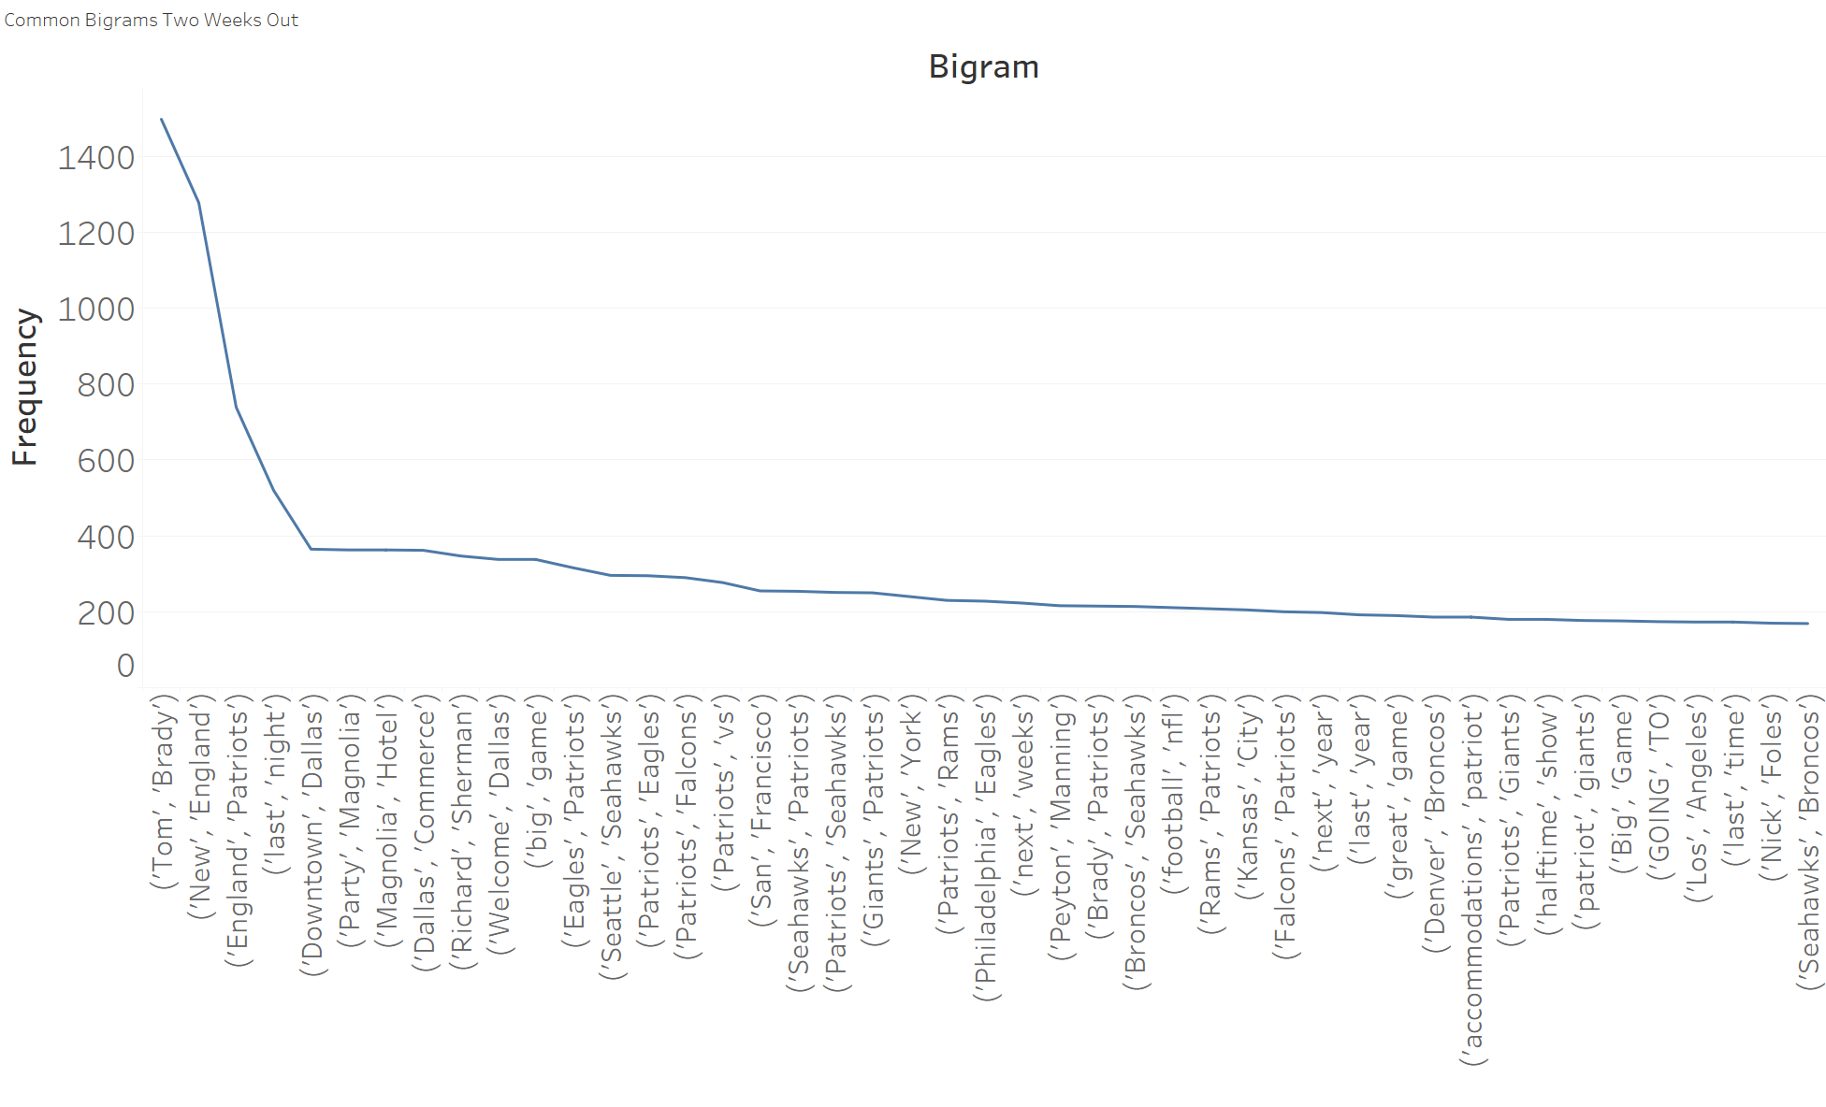
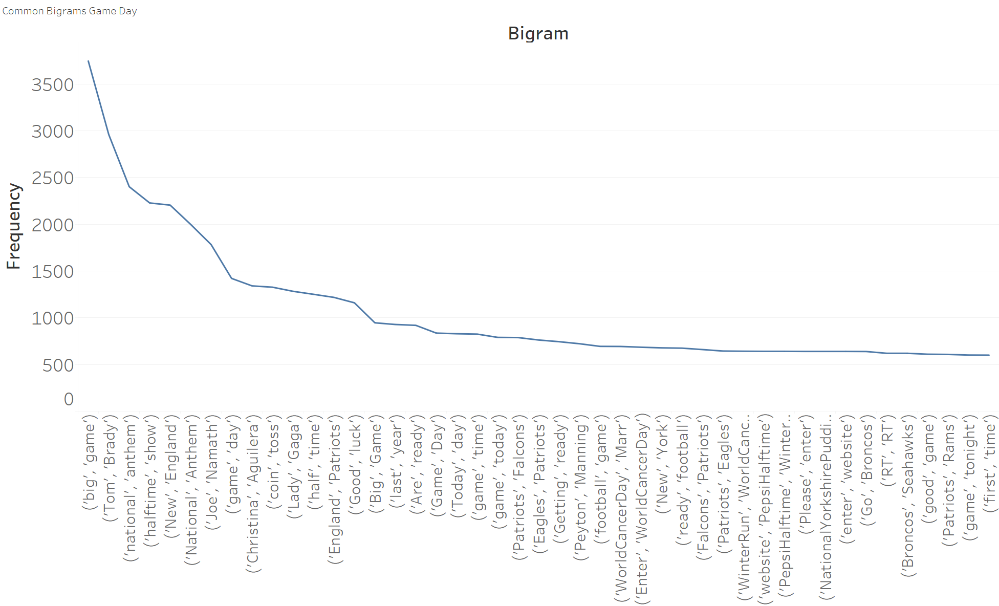
Text Representation - N-grams
Analysis of bigrams two-weeks out shows frequent team and player references
Game day tweets highlight specific events within the game or noticeable NFL historical figures: national anthem, halftime, Joe Namath, etc.

Slide 9
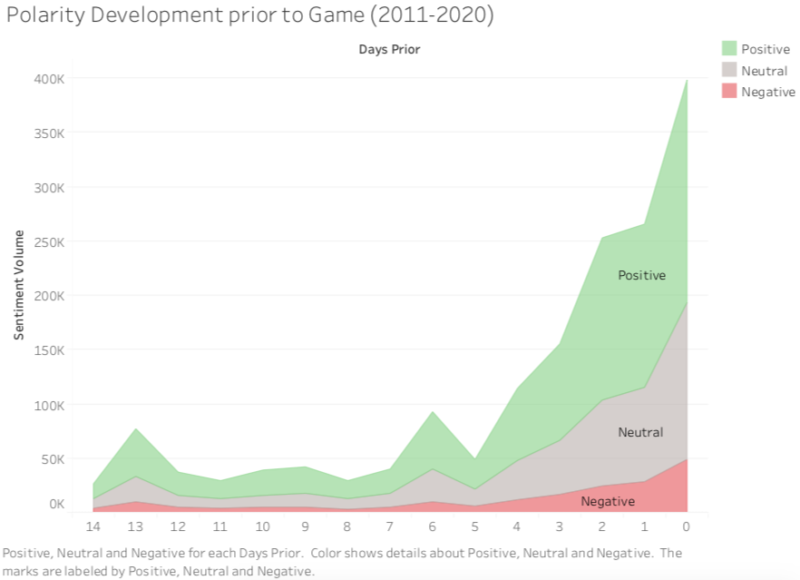
Sentiment Analysis
Majority of tweets had a positive polarity leading up to the game.
People are excited and in high-spirits

Slide 10
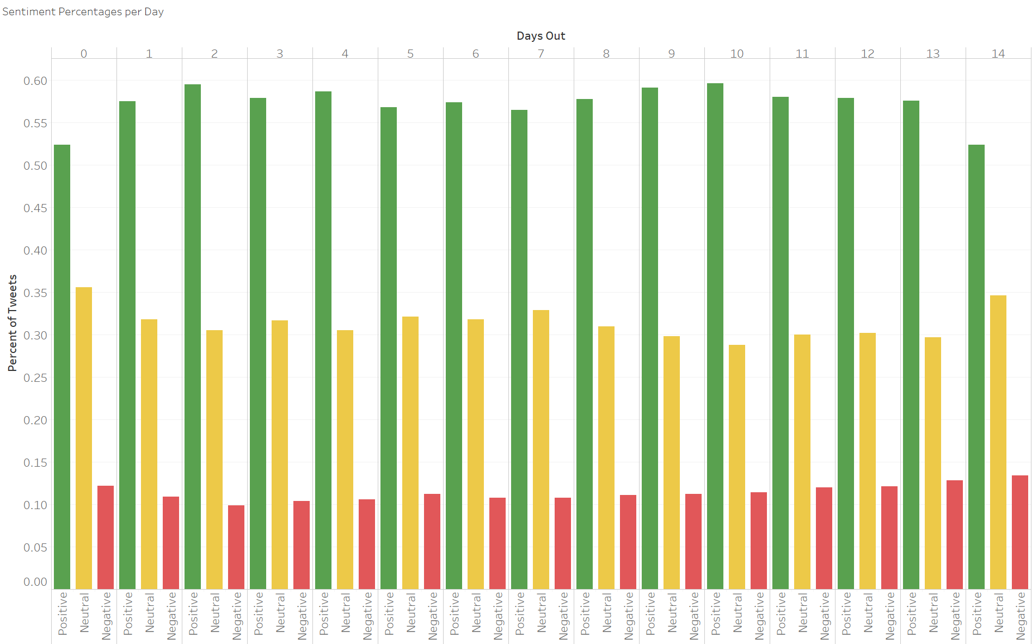
Sentiment Analysis
The highest percentage of positive tweets occur on weekdays in the lead up to media day and Super Bowl Sunday

Slide 11
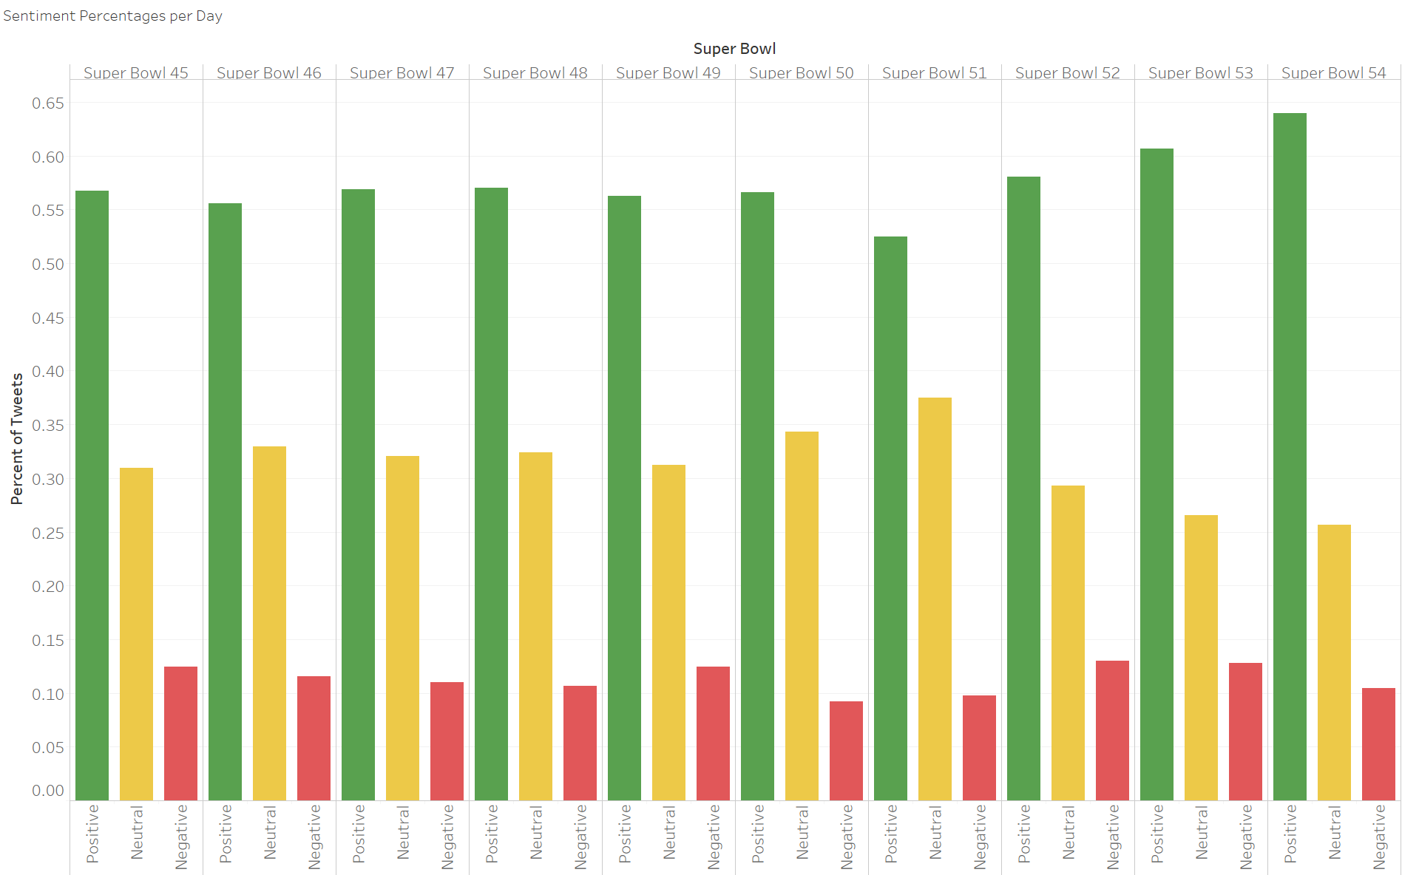
Sentiment Analysis
Super Bowl 54 (KC vs SF) had the highest percentage of positive tweets
Super Bowl 52 (NE vs PHI) had the highest percentage of negative tweets

Slide 12
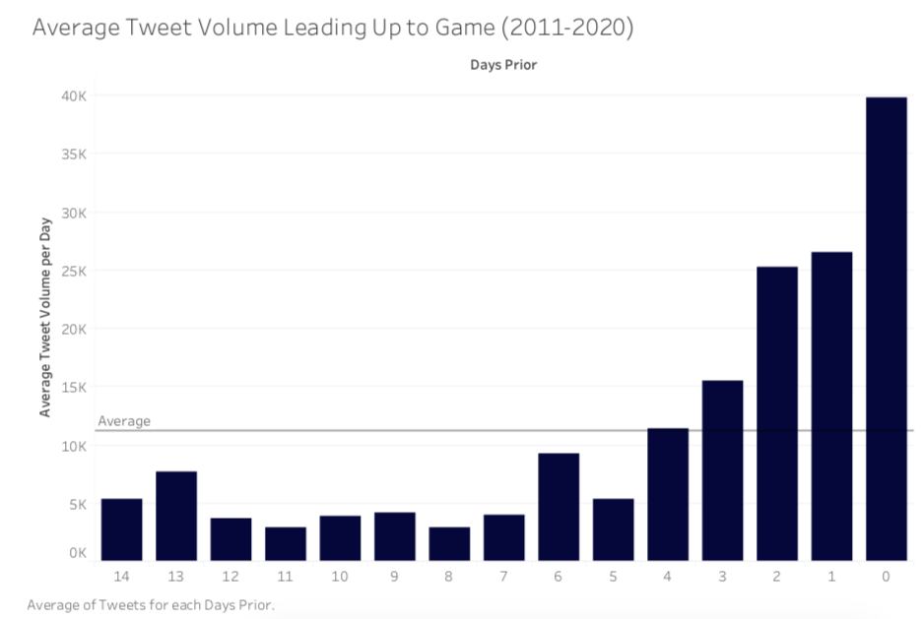
Tweet Volume
High volume of tweets prior to Super Bowl kick-off
High user engagement in twitter with approximately 40K tweets

Slide 13
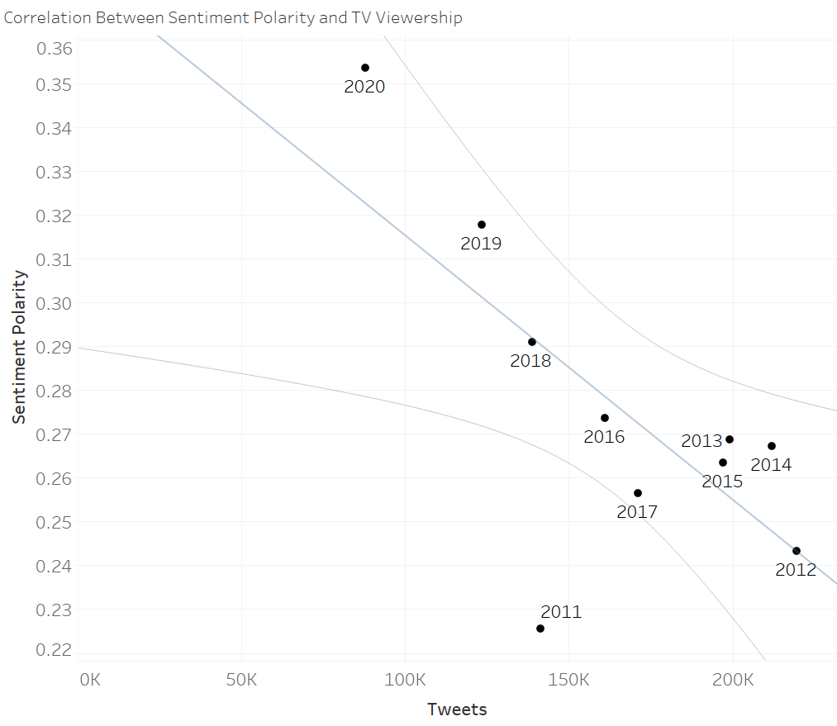
Tweet Volume and Sentiment Correlation
Strong negative correlation between number of tweets and sentiment polarity
Unfortunately, suggests sentiment may be irrelevant to predicting viewership

Slide 14
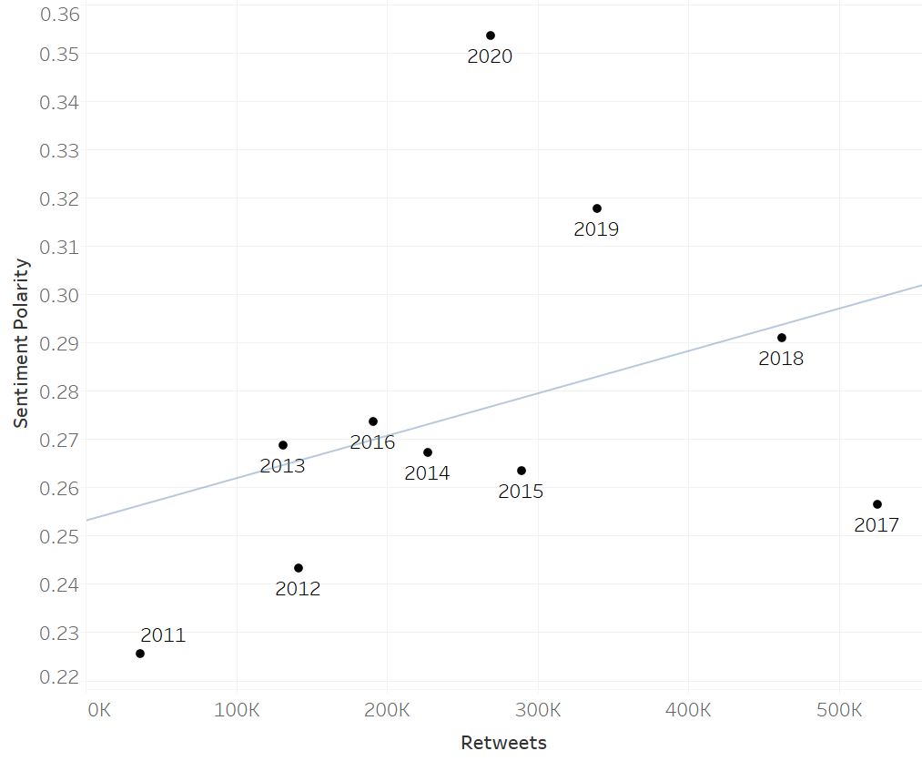
Retweet Volume and Sentiment Correlation
The number of retweets has drastically increased since 2011, and also appears correlated to the increase in sentiment polarity
With more retweets, fewer unique tweets may be generated, amplifying the positive tweets and skewing the sentiment

Slide 15
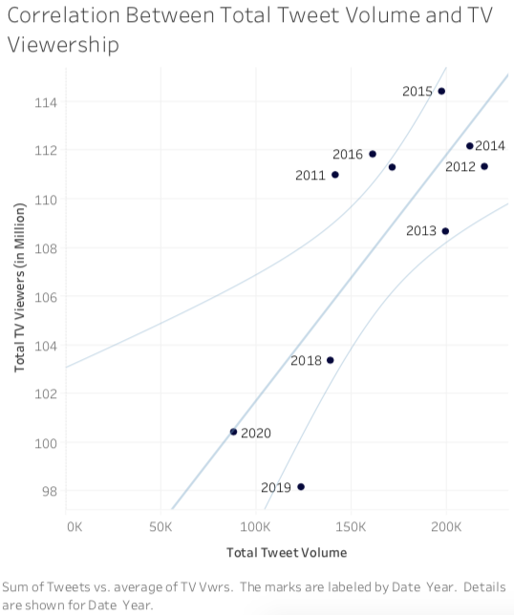
Tweet Volume and Viewership Correlation
Strong positive correlation between tweets and average television viewership numbers
As more tweets are posted, a higher television viewership is predicted

Slide 16
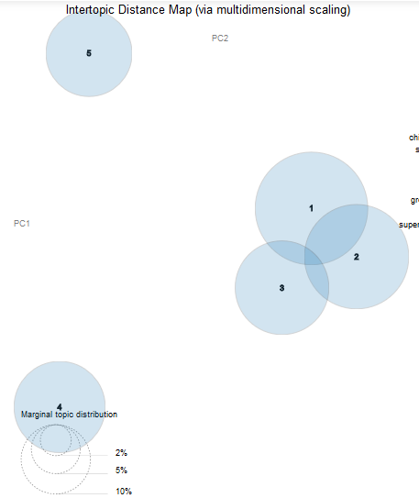
Topic Modeling
Compare Topics from 2011 and 2020 Super Bowl
Gensim Package and LDA Algorithm in Python
Explore different Topics
2011: Halftime Show, Commercials
2020: Food, Teams, Ads
Possible Use
Understand purpose of tweet
Remove noise from data
Problems: Difficult interpretation of Topics
2020 Intertopic Map

Slide 17
Conclusion
Sentiment of tweets varied depending
Teams
Week or Weekend
Events before kick-off - Media Day
Term frequency analysis provides interesting marketing suggestions leading up to Super Bowl Sunday
Two weeks out: Team Hype
Game day: In-game events, Super Bowl History
Tweet sentiment has little impact on predicting TV viewership
Increase in retweets over time may positively skew sentiment
Positive correlation between television viewership and number of tweets - most impactful predictor

Slide 18
Recommendations
Include tweets without #hashtags and with more #hashtag variety
Analysis of tweets based on location and TV viewership
Expand to other social media platforms
Expand to other sporting events, such as Olympics, World Cup, etc.

